Slide 1

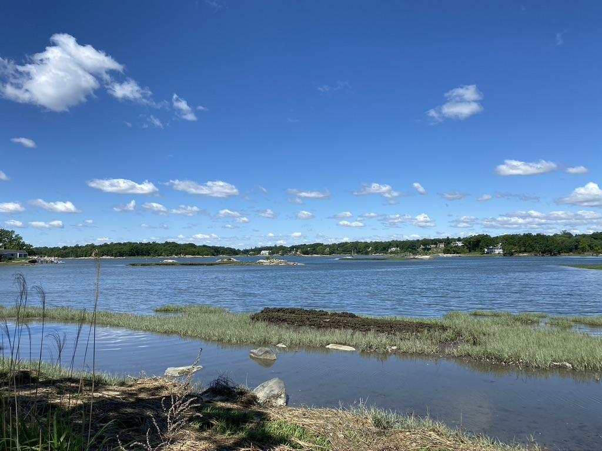
TOKENEKE ASSOCIATION
2023 Annual Meeting
4 June 2023

Slide 2
AGENDA
Introduction to the Association
History and Function of the TA Michael
FY 22 Board of Directors Michael
The Association & The Tax District Scott
Treasurer’s Report
2023/2024 Budget Scott
2022/2023 Performance Scott
Insurance Scott
Amendment to By Laws Jack
Committee Reports
Security Quinten
Development Jack
Roads/Drainage/Trees Holt, Winston
Social Jamie
Welcoming Livia
Beautification Liza
Nominating & Introduction of Board Members Joan
Our Asks and Q & A Michael/All
Notes:
TIMING- 35 min + 10 min Q/A:
Intro- 8 min Treasurer/insurance- 3 min Amendment- 4 min Committees- Security 5 min Development 1 min Roads 3 min Social 5 min Welcoming 2 min
Beautification 2 min Nominating 2 min
Q/A 10 min

Slide 3
Introduction to the Association
The Tokeneke Association (TA) is the entity that owns the roads and maintains the Park.
The TA manages the operations including the special police department (Constables), roads, security, snow plowing, events, etc.
The primary purpose of the TA Annual Meeting is to provide information to the resident community about issues facing the Association, what the Board has accomplished over the past year, and what the Board plans to address in the coming year and beyond. It is also an open forum for residents to engage the Directors of the board with questions, comments, and ideas.

Slide 4
TA Board: FY 2022
CLASS of 2023
Livia Boova (Social)
Jamie Hamon (Social)
Quinten Stevens (Security)
Tara Leclerc (Communications)
CLASS of 2024
Holt Smith (Roads)
Liza Smith (Beautification)
Robert Wilson (Insurance)
CLASS of 2025
Michael Casolo (President)
Jack DeVita (VP, Development)
David Madon (Secretary)
Caroline Rosen (Welcoming, Social)
CLASS of 2026
Scott Appleby (Treasurer)
Joan Meyjes (Nominating)
Haley Sonneland (Communications)
Winston van Buitenen (Roads)

Slide 5
The TA and the TTD
The Tokeneke Tax District (TTD) was established and empowered by the CT state legislature to levy and collect a tax on property owners to maintain the roads and special police protection.
The primary purpose of the TTD's annual meeting is to adopt the 2023-2024 budget, fix the tax rate, and allocate the funds (note: this meeting was held in May)
The mill rate is applied to the same assessed property value that the Town of Darien uses.
The Tokeneke Association is then charged with carrying out the provisions and projects designated within the budget.
The formulation of the budget is a collaborative effort between both boards.

Slide 6
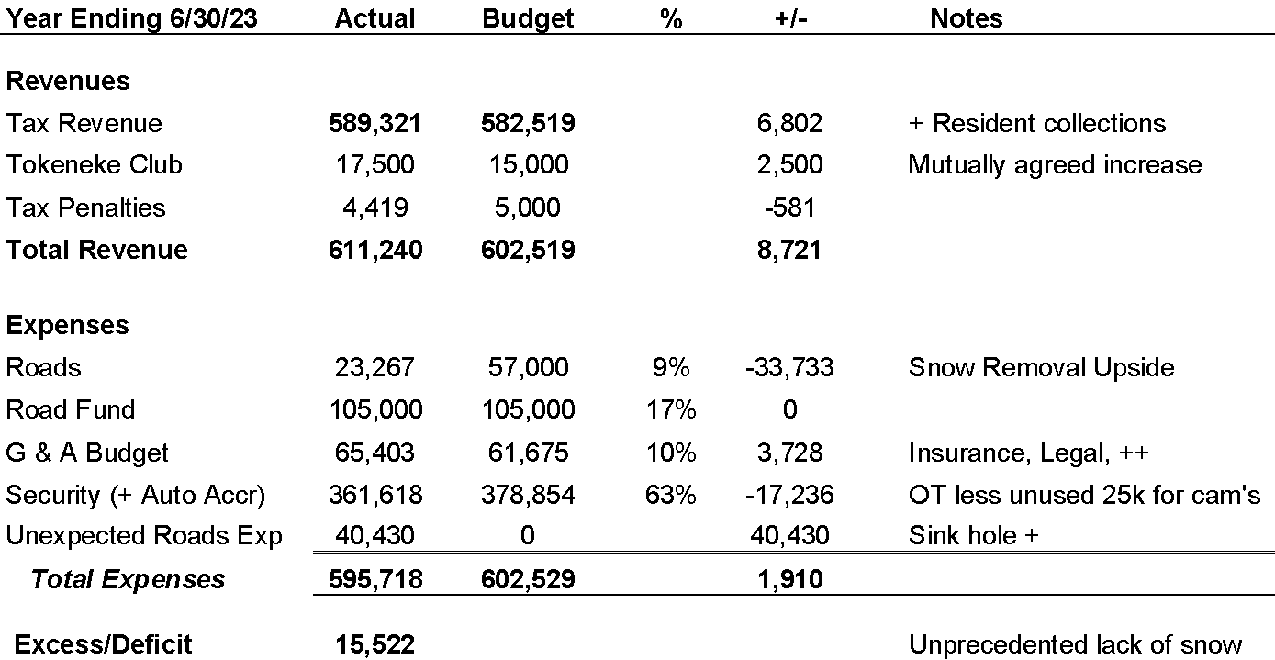
2022/23 TA Actual v. Budget

Slide 7
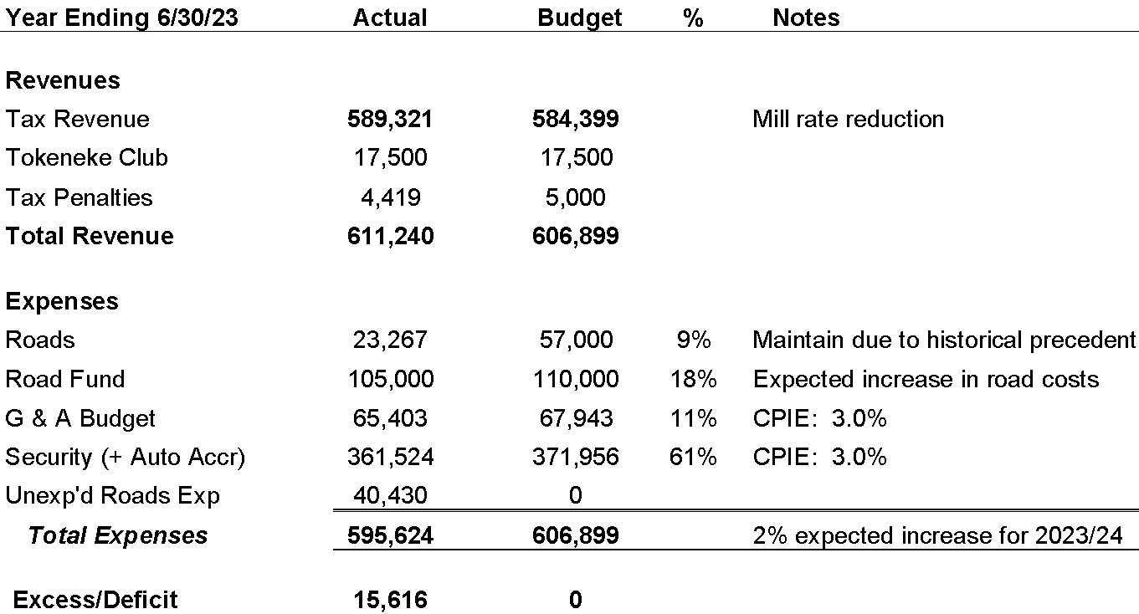
2023/24 TA Budget: Approved at May 15 TTD Ann. Mtg.

Slide 8
Insurance Summary
 | Policy | FY 22-23 | FY 23-24 | Difference
 | Directors and Officers | $ 4,819 | $ 4,819 | $ - |  | 0.00%
 | Automobile | $ 5,503 | $ 5,443 | $ (60) |  | -1.09%
 | General Liability | $ 11,001 | $ 11,609 | $ 608 |  | 5.53%
1 | Umbrella Excess | $ 13,200 | $ 15,800 | $ 2,600 |  | 19.70%
 | Law Enforcement Liability | $ 3,678 | $ 3,830 | $ 152 |  | 4.13%
 | Workers Compensation | $ 11,885 | $ 11,847 | $ (38) |  | -0.32%
2 | Crime Bond - 3 years (1/4/19 - 1/4/22) * | $ 1,788 | $ 2,913 | $ 1,125 |  | 62.92%
 | Total | $ 51,874 | $ 56,261 | $ 4,387 |  | 8.46%
1 | The increase on the Umbrella/Excess Liability policy is based on rate increases across all insurance carriers for this line of business.
2 | The premium increase on the Crime policy is based on adding coverage for forgery, alteration, computer crime and funds transfer to the 2022 policy term. The 2019-2022 Crime policy had coverage for employee theft only.

Slide 9
By Law Amendment: Article III, Section 1
CURRENT LANGUAGE:
Election of any Directors at the Annual Meeting will be by a majority vote of those Members eligible to vote (See Article VI, Section 3).
PROPOSED LANGUAGE:
Election of any Directors at the Annual Meeting will be by a majority vote of those Members eligible to vote (See Article VI, Section 3) and who are present at the Annual Meeting.
ACTION:
Call for a Motion, a Second, and a Vote

Slide 10
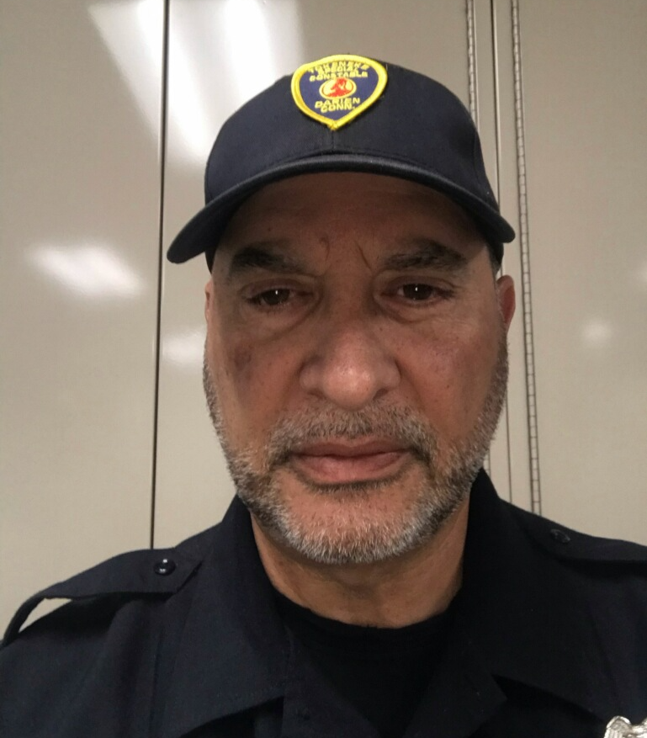
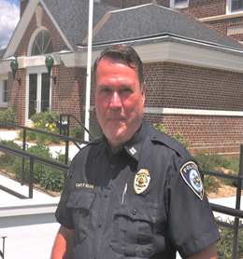
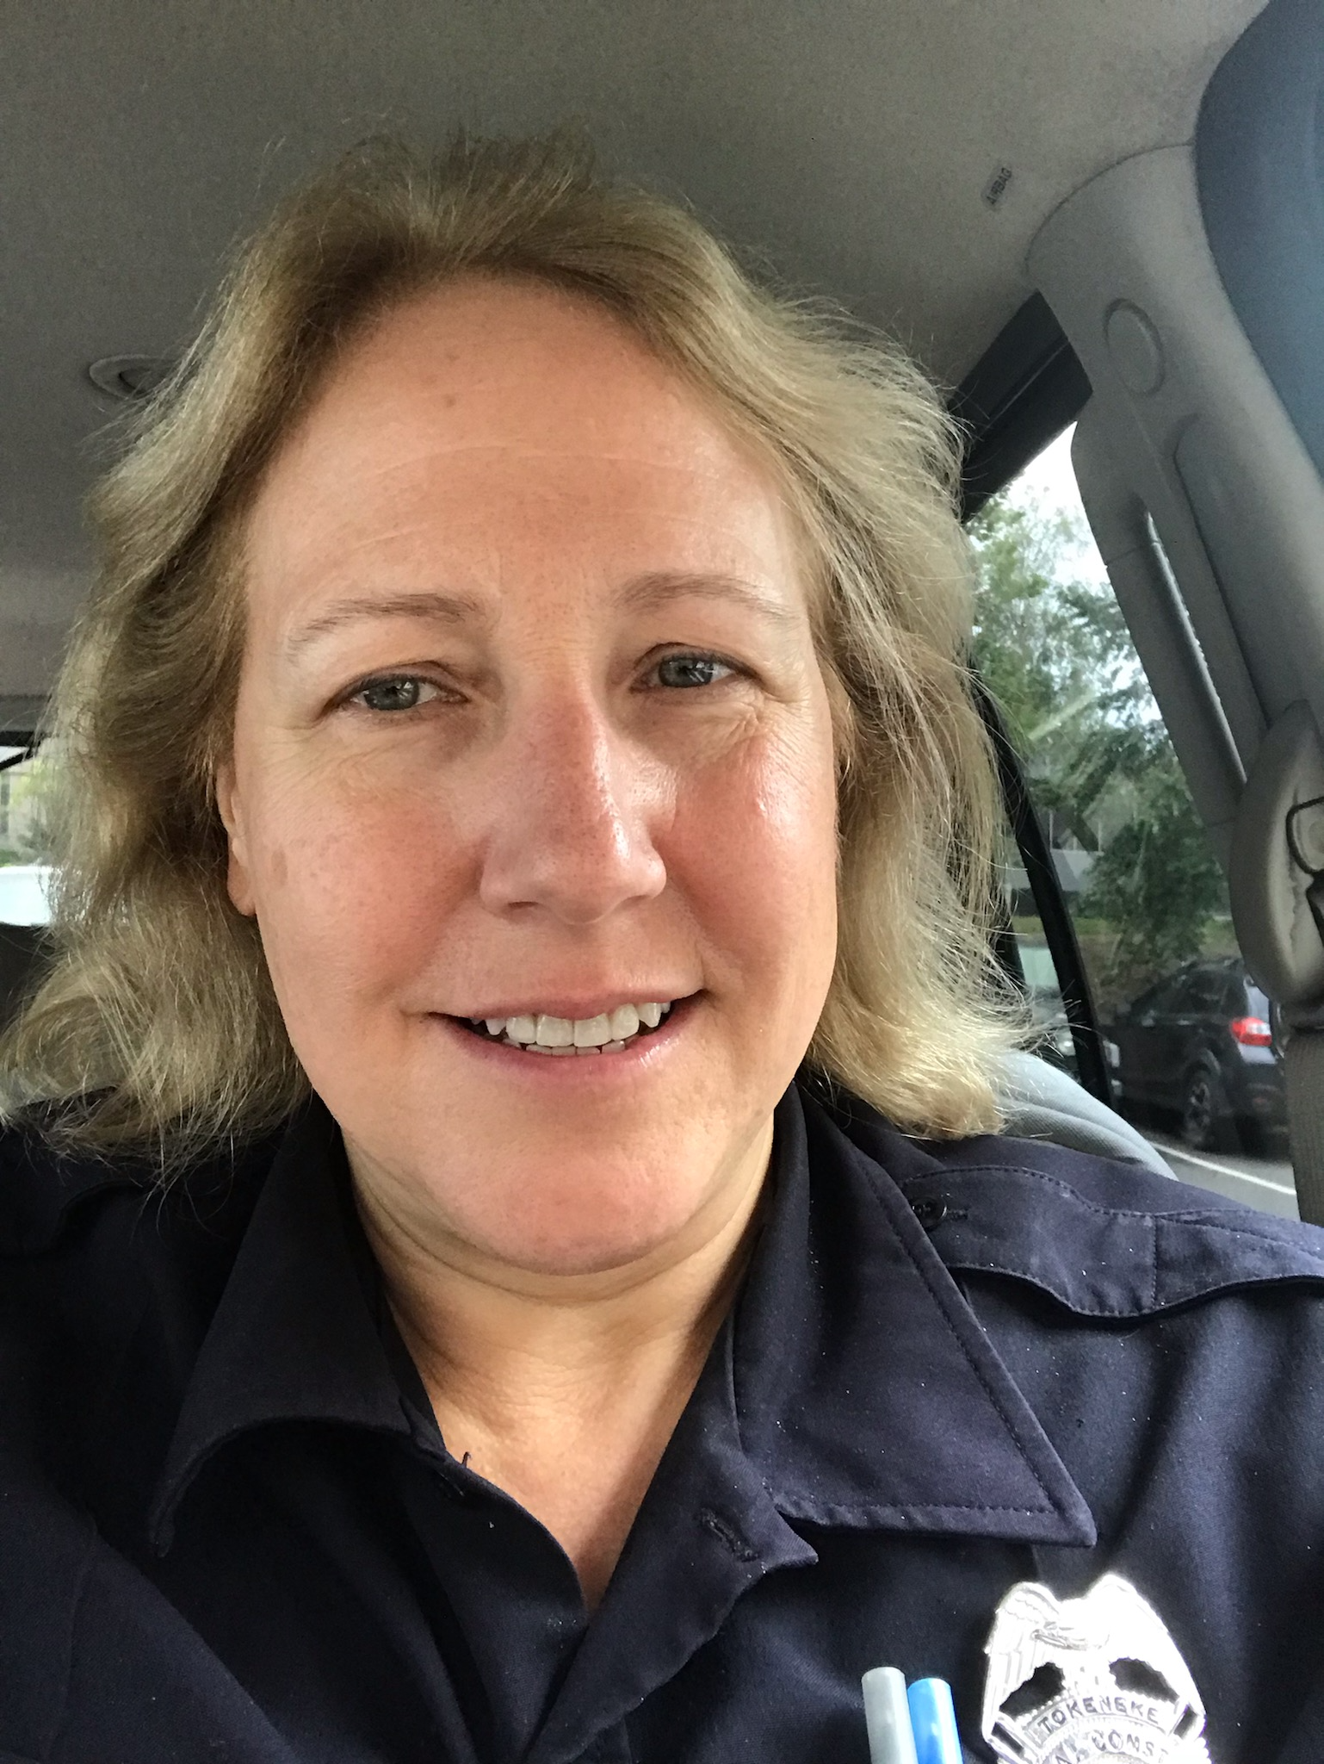
Security- Our Team
Retiring
Sam Boccuzzi
Senior Special Constable
TPP since 2019
Fred Komm
Special Constable Retiring June 2023
TPP since 2013
Kathy Conlin
Special Constable
TPP since 2016

Slide 11
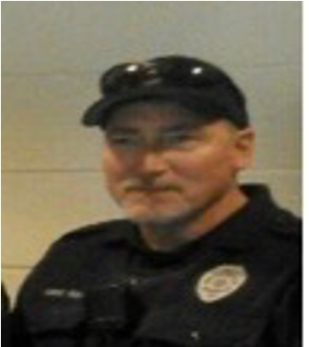
Security- Newest Addition
Darien PD since 1997
Lives in Stratford
Has worked in security at Fairfield University since his retirement from Darien
Launched Darien’s ‘Kids and Cops’ program
Worked closely with The Depot and Middlesex Middle School to introduce teens to the Darien PD
Court Isaac
Special Constable
TPP starting June 2023

Slide 12
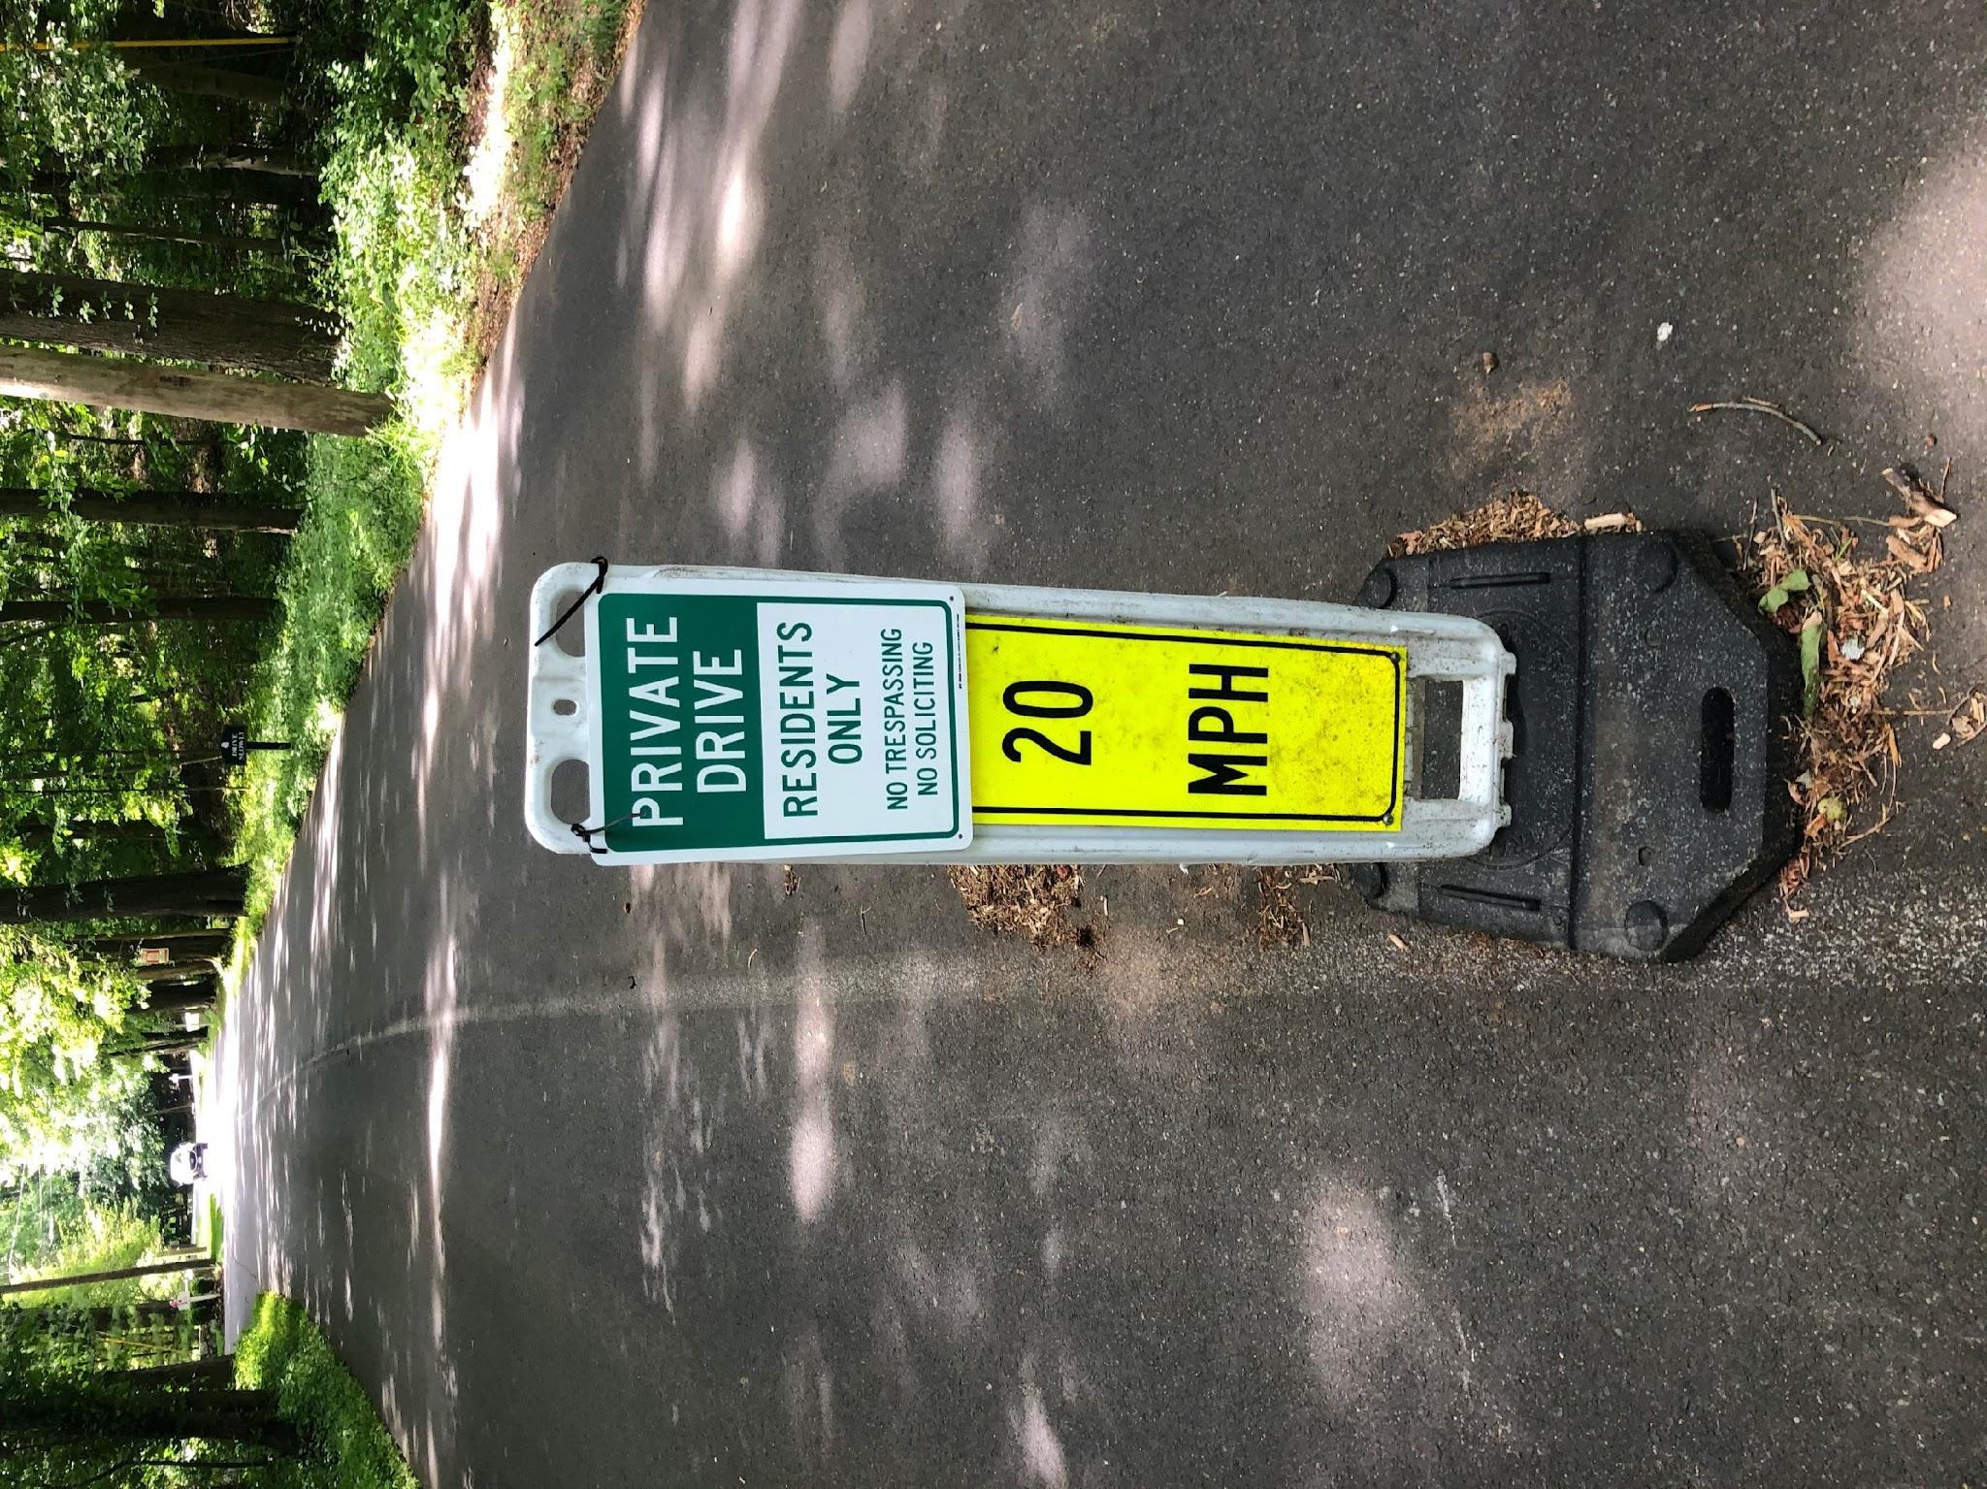
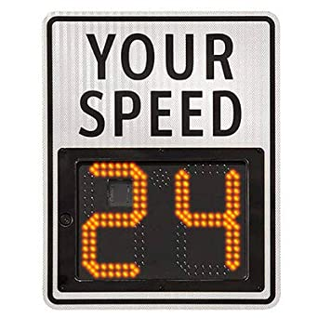
Security- Role of Constables
Constables are able to enforce LAWS, not RULES
ENFORCEABLE:
Speeding
Crime
Trespassing (including non-resident use of Roads
NOT ENFORCEABLE:
Neighbor to neighbor property disputes
Worker/construction hours*
*will assist with notifying violators when possible

Slide 13
Security- Protecting Ourselves
LOCK your doors at all times
LOCK your car at all times
DO NOT leave keys and fobs IN or NEAR your vehicle
INSTALL and MONITOR video surveillance (low-cost systems such as Ring are very effective)
INFORM TPP when you are going to be away from home (vacations, etc.)
CONTACT:
Patrol: 203 979 3130
tokenekepolice@gmail.com
For EMERGENCIES: ALWAYS DIAL 911

Slide 14
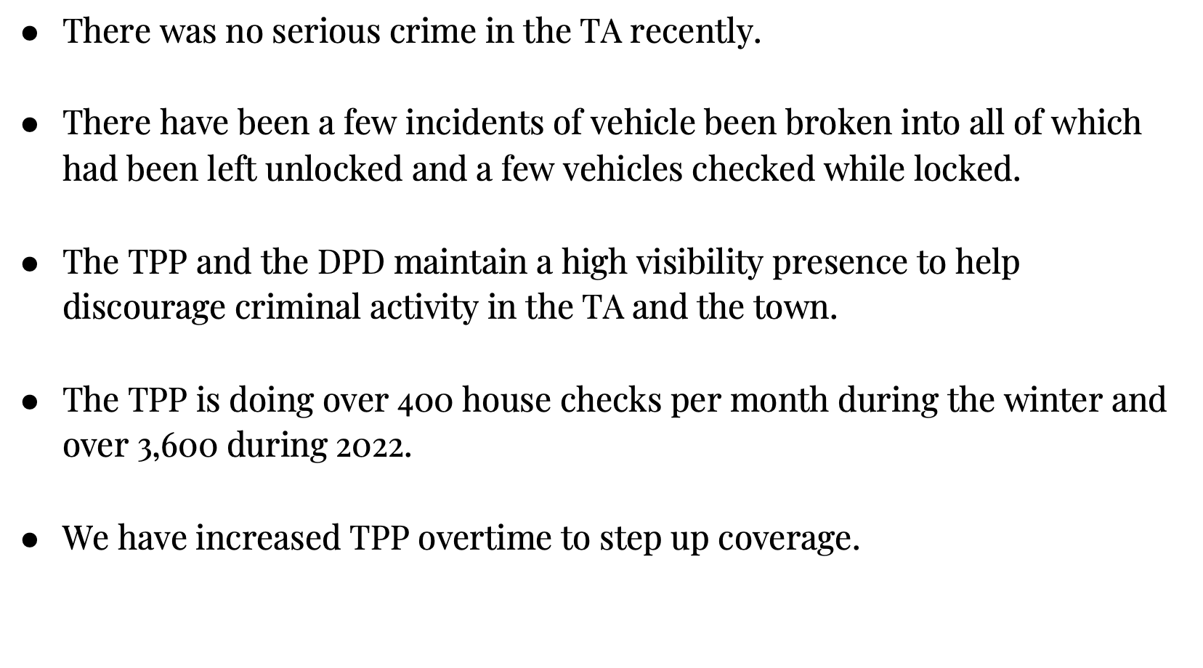
Security- Update on Activity

Slide 15
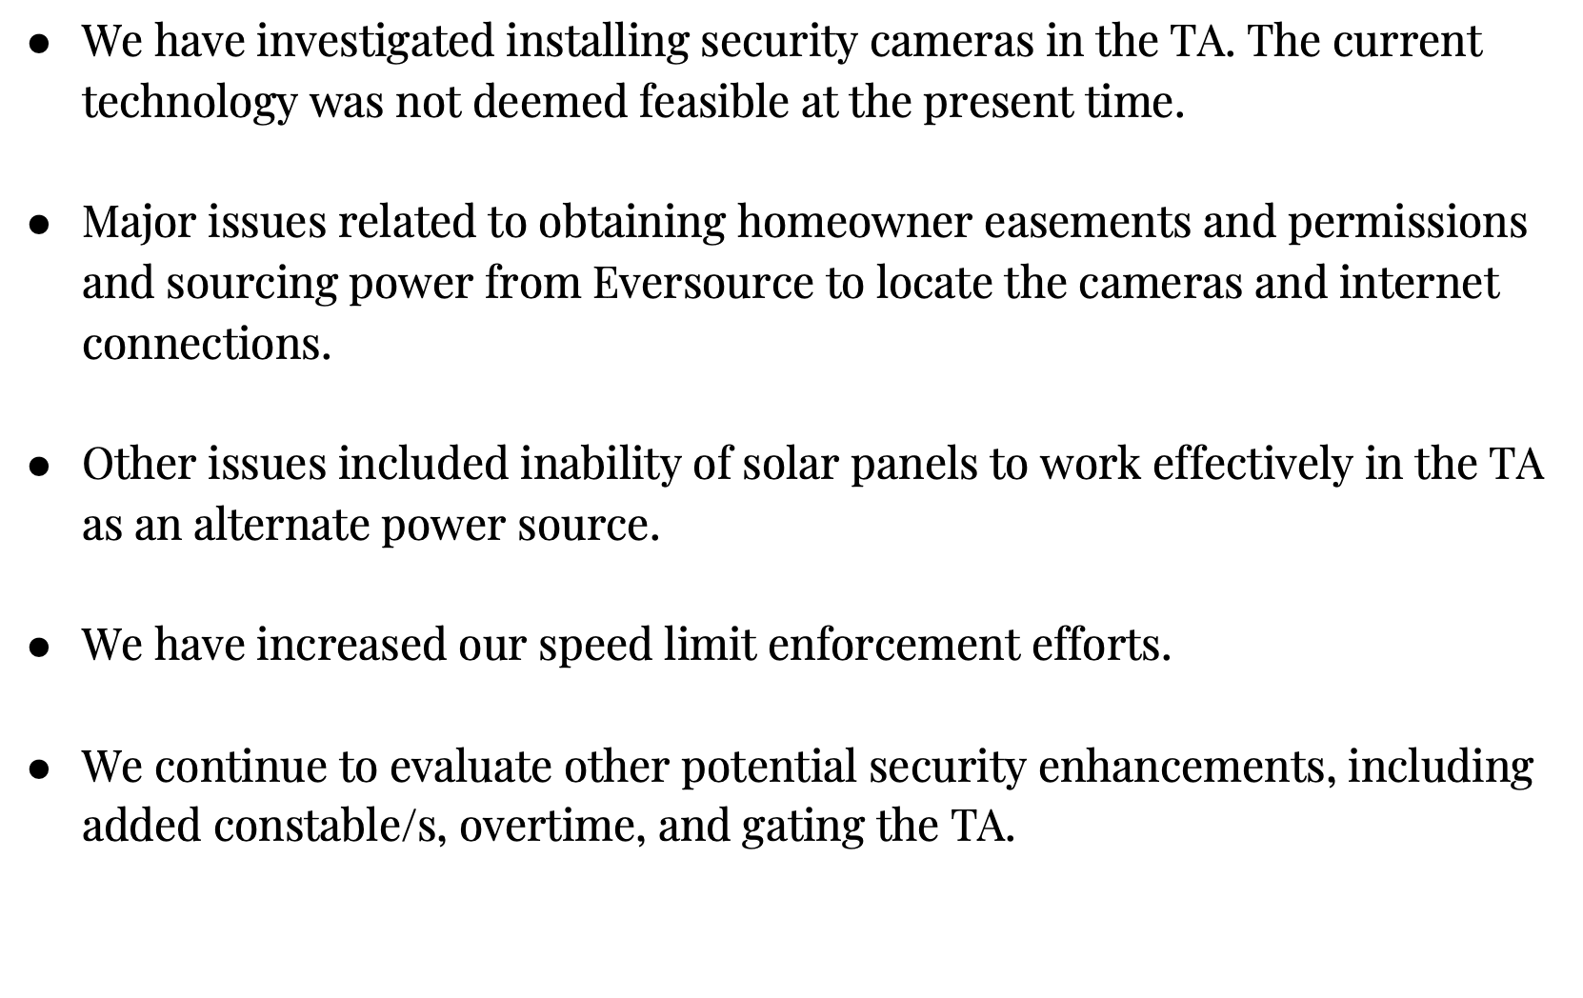
Security- Being Proactive

Slide 16
Development
Monitor permitted projects and collect deposits for those in excess of
$250,000 in value
Objective is to notify residents and contractors of certain rules and
protect association property
Deposits are returned upon receipt of C/O and no excess wear and
tear is identified.
Program has been in place for ~3 years and well received by residents
Currently holding $31,000 in deposits from 8 residents/projects.

Slide 17
Roads, Drainage & Trees (RDTC)
RDTC is responsible for monitoring and maintaining the safe functioning of all of the TA’s common area roads, drainage systems and trees.
Our 7.2 miles of roads have an estimated useful life of between 16-20+ years and are repaved in pre-designated sections based upon the recommendations of paving experts.
We strive to conservatively maintain the paving capital fund of approximately $775,000 to cover 2/3rds of the cost to repave all TA roads.
We are responsible for the annual operating budgets covering routine repair and maintenance items, and for the cost for snowplowing.
For FY 2023:
Rebuilt the roadbed at top of Canoe Trail to deal with recurring sinkholes
Repaired the sinkholes at the foot of Winding Lane
Repaved Winding Lane
Repaired the scuppers at the Searles-Contentment Island Causeway

Slide 18
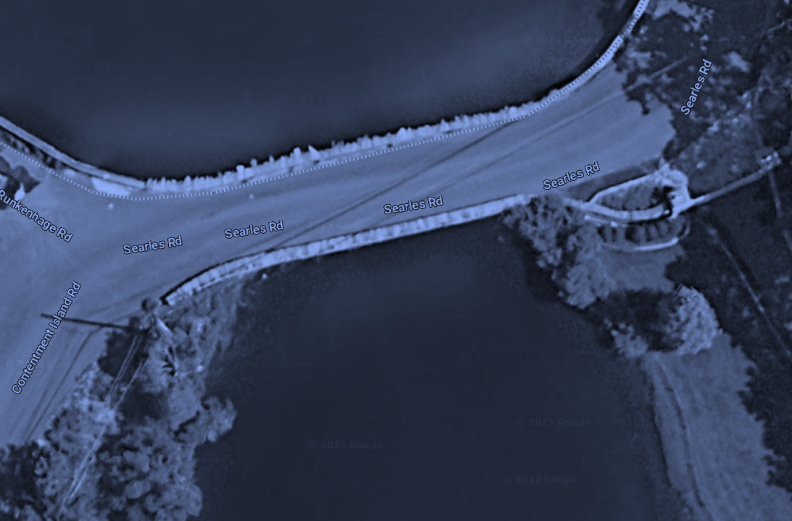
RDTC
For FY 2024:
We will be having a coastal engineering firm work with the TA to obtain DEP and other required approvals for repairing the Searles-Contentment Island seawall.
We are planning to engage the coastal engineering firm to provide recommendations to minimize flooding between the Searles-Contentment Island causeway and Butler Island.
No TA roads have been judged as requiring paving in FY 2024.
We welcome notifications of any potentially unsafe or non-functioning conditions related to our common areas.

Slide 19
Social
2023/2024 SOCIAL DUES
$95 per household (optional)
Estimated funds: $20,000 (80% HH)
2023/2024 PLANNING
Block Party
Halloween
Holiday Gathering
Easter Egg Hunt
Adult Cocktail Party
Annual Meeting with Social Hour
Darien Land Trust Partnership TBD
2022/2023 EVENTS
Block Party
Halloween
Holiday Gathering
Easter Egg Hunt
Annual Meeting
Notes:
272 homes in TA
approx budget $13,600 with 50% HH participation rate, $19,380 with 75% HH participation rate
TOTAL EVENT COSTS $22,800
TOTAL SOCIAL BUDGET: $20,575

Slide 20
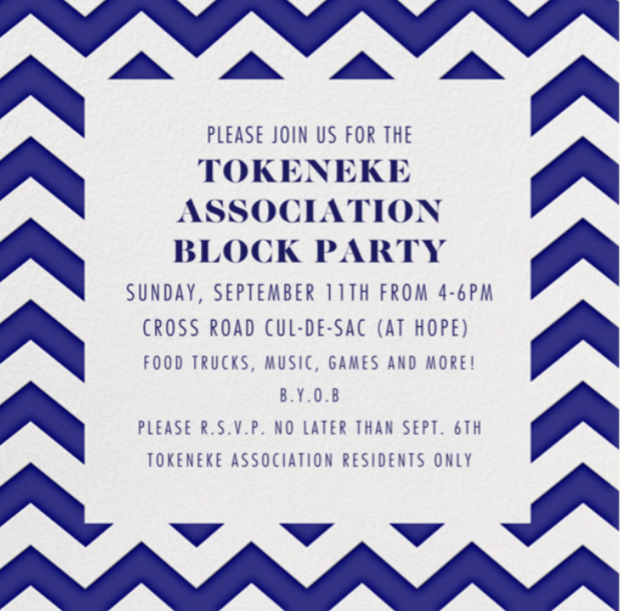
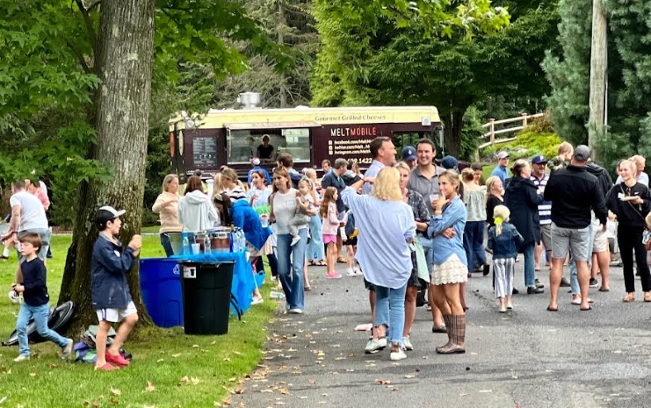
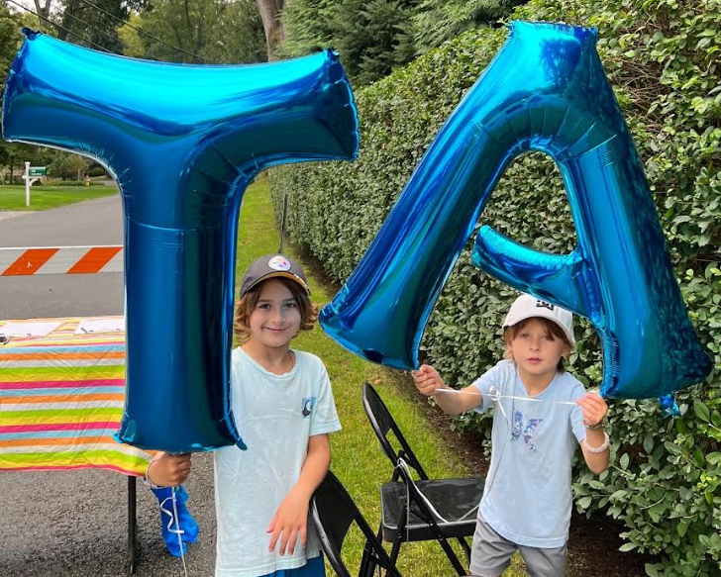
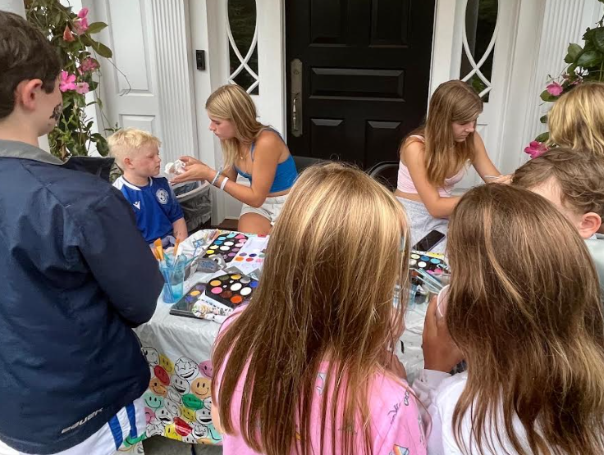
Social: FY 2022 Events
Block Party
Timing: September 11
Cost: $13,500
Attendance: 420 guests
Food & Ice Cream Trucks
DJ, Magician, Face Painting
TA Roadie Cups

Slide 21
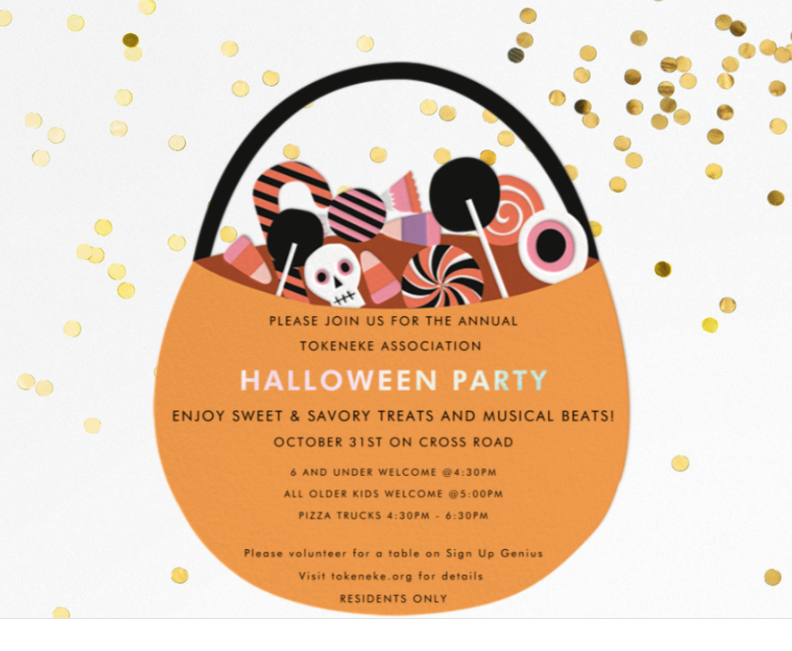
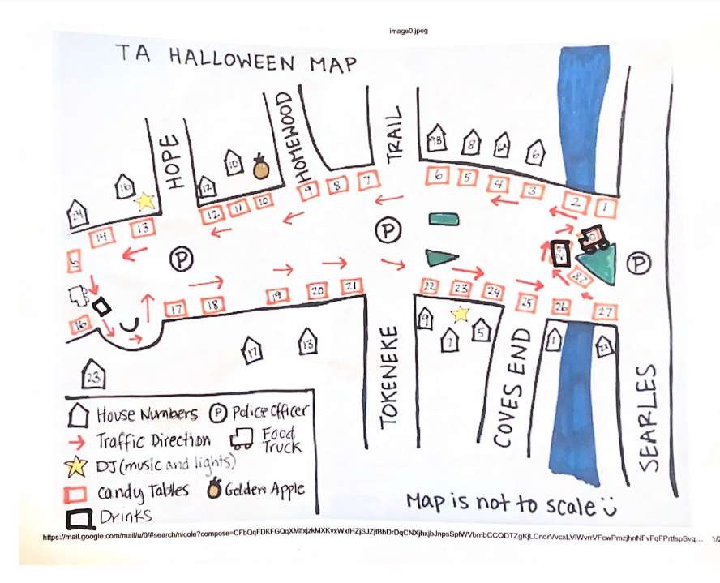
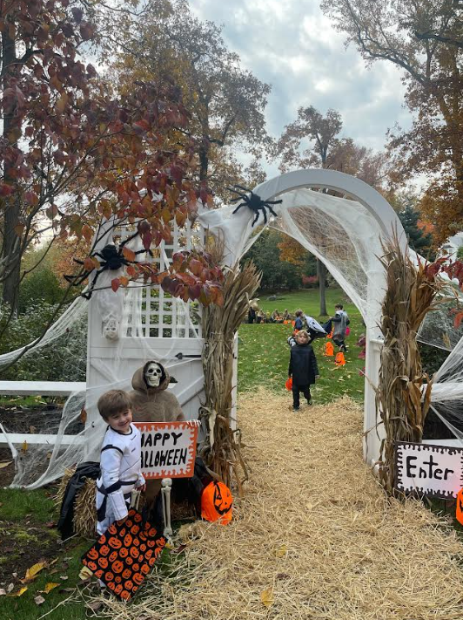
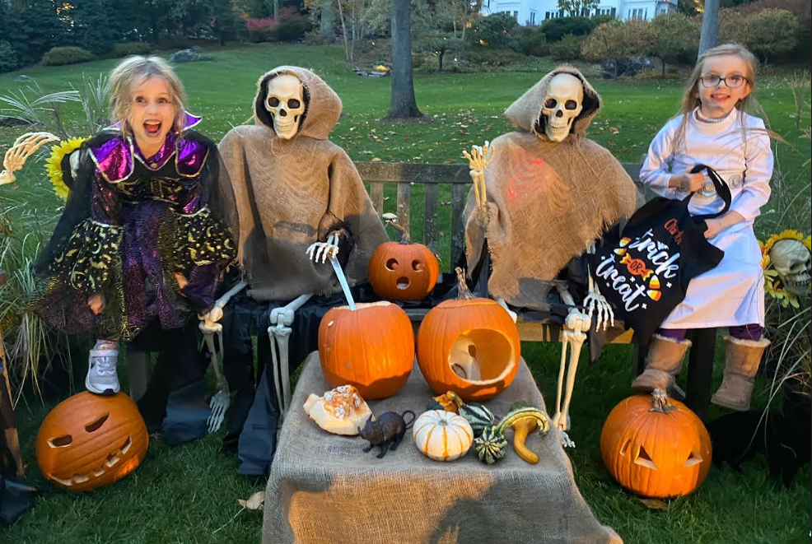
Social: FY 2022 Events
Halloween Party
Timing: October 31
Cost: $6,500
Attendance: 300+ guests
28 Trick-or-Treating Tables
(2) Gourmet Pizza Trucks
DJs, Glowsticks

Slide 22
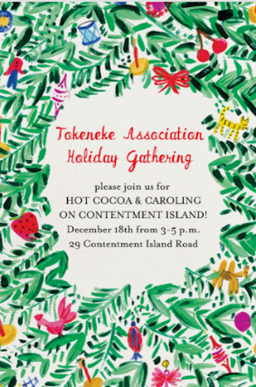
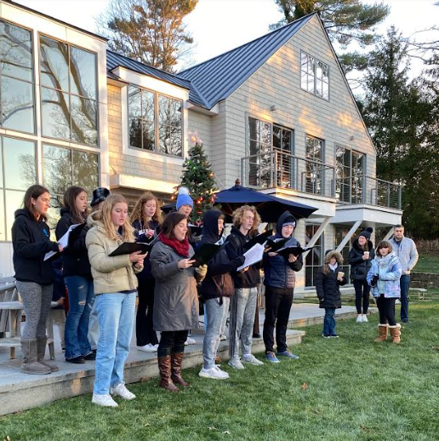
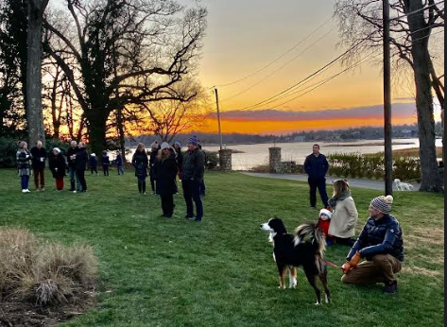
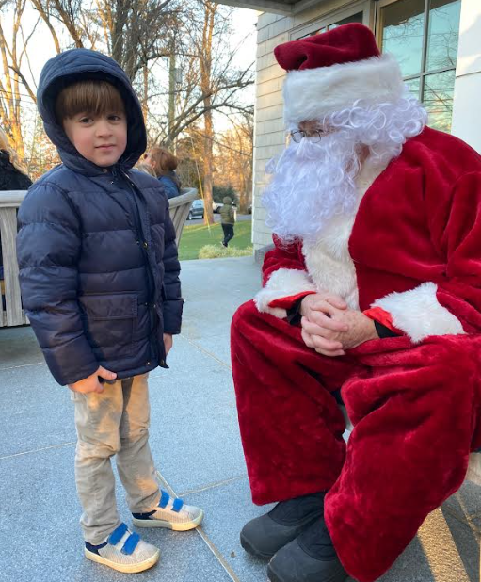
Social: FY 2022 Events
Holiday Gathering
Timing: December 18
Cost: $1,950
Attendance: 120 guests
Ben & Jerry’s Hot Cocoa Truck, Cookies, Schnapps
Carols by DHS Tutors Orchestra
TA Coffee Mugs
Ornament Exchange

Slide 23
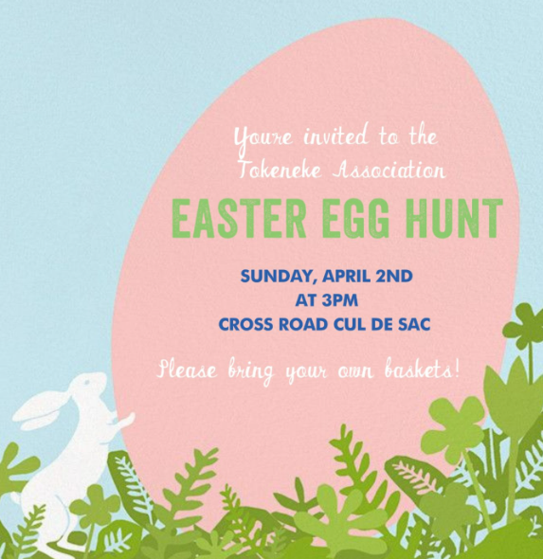
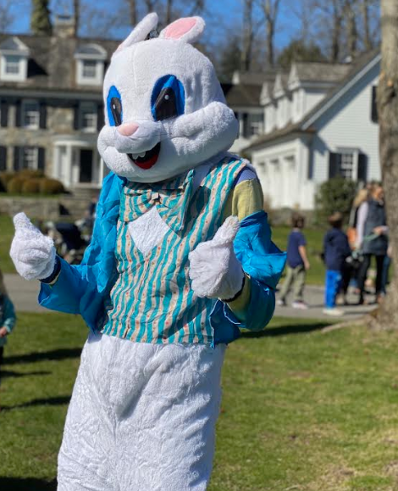
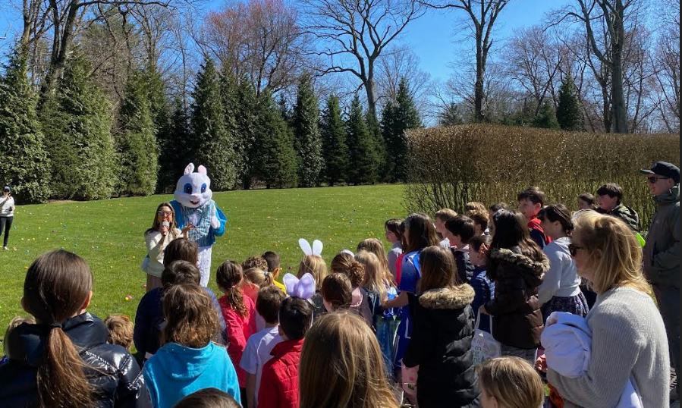
Social: FY 2022 Events
Easter Egg Hunt
Timing: April 2
Cost: $850
Attendance: 210+ guests
1,800+ Easter Eggs
Easter Bunny
Sweet treats

Slide 24
Social: Survey Results
Main Takeaways
Tokeneke Association likes to party!
Halloween will become ‘food truck kick-off’ with traditional trick-or-treating ON Halloween night itself
Families enjoy the holiday gathering and block party
Interest in adult-only cocktail party and both women’s and men’s events

Slide 25
Welcoming: FY 23 Activity
16 New Neighbors (approx. 6% turnover)
17 Transactions in the neighborhood from April 2022-May 2023
Welcome bag includes the following as well as a note from the Board
TA grocery tote
TA handbook
TA history book
TA mugs and fresh ground coffee beans
TA car stickers and a note
There are currently 7 active ‘for sale’ listings in the Association

Slide 26
Welcoming: New Neighbors
Pam & Tony Harrington
Owen & Catherine Buckley
Jane & Jon Rather
Abby & Erik Ward
Anna & Justin Patterson
Natalie & Douglas Doughty
Amanda & Rory Callahan
Jeffery & Chelsea Leach
Jessica Murphy & Michael Mulcahy
Colleen Casey
Lou and Ginny LaRocca
Amanda & JP Spatola
Laura Parker
David & Liz Haines
Thomas & Selma Savage
Daniel Saval & Ulyana Bardyn
6 Homewood Lane
5 Indian Trail
11 Winding Lane
14 Winding Lane
11 Searles Road
28 Old Farm Road
2 Tokeneke Beach Drive
8 East Trail
11 Arrowhead Way
8 Searles Road
11 Hope Drive
11 Searles Road
25 Searles Road
68 Arrowhead Way
43 Old Farm Road
25 Winding Lane

Slide 27
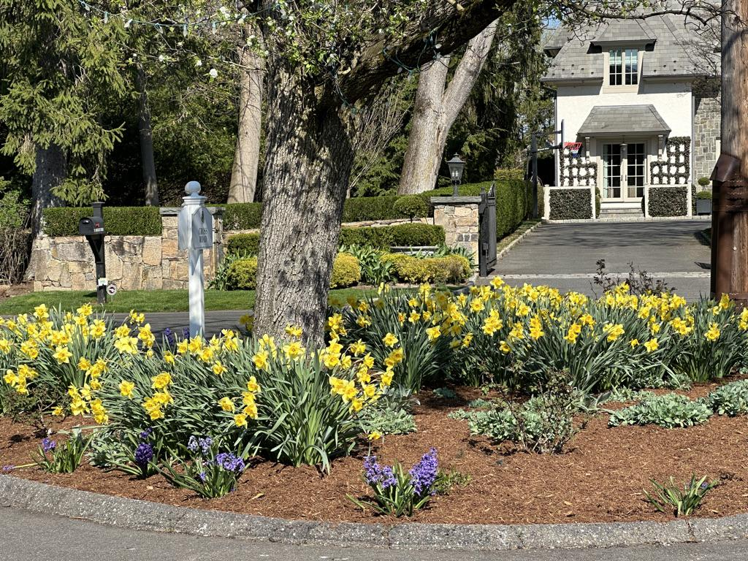
Beautification
What We Do
Maintain islands at Cross & Tokeneke Trail and Cross & Searles
Provide holiday lighting at Cross Road Islands
Maintain Association-owned landscaped areas
Maintain signage

Slide 28
Nominating: FY 23/24 Board
CLASS of 2024
CLASS of 2025
CLASS of 2026
Holt Smith* (Roads)
Liza Smith (Beautification)
Robert Wilson (Insurance)
Michael Casolo* (President)
Jack DeVita* (VP, Construction)
David Madon* (Secretary)
Caroline Rosen (Welcoming)
Scott Appleby* (Treasurer)
Joan Meyjes (Nominating)
Sarah Walker* (Communications)
Winston van Buitenen (Roads)
Livia Boova (Social)
Jamie Hamon (Social)
Quinten Stevens* (Security)
*denotes Executive Committee

Slide 29
Our Asks of You
LOCK your cars and homes at all times
CLEAN UP after your pets
ALERT TPP to any unusual sightings- let them follow up
CALL 911 for ALL EMERGENCIES
DISCOURAGE your non-resident neighbors from walking/biking in the Park
FOLLOW the Speed Limits…bottom line: KEEP OUR STREETS SAFE FOR ALL
INFORM your service workers of the TA Hours and Days of allowable work and Speed Limits
BE a courteous neighbor
JOIN the Social or Beautification Committees to help make our neighborhood the attractive, safe & connected place that we all hold near and dear
REGISTER your email on the website: www.tokeneke.org so that you are informed of events, security notices and other matters

Slide 30
WRAP
QUESTIONS
COMMENTS
SUGGESTIONS HOT DOGS (and more!)

Slide 31
ENJOY A GREAT TOKENEKE SUMMER!

Slide 32
Appendix
Social Survey Results Summary

Slide 33
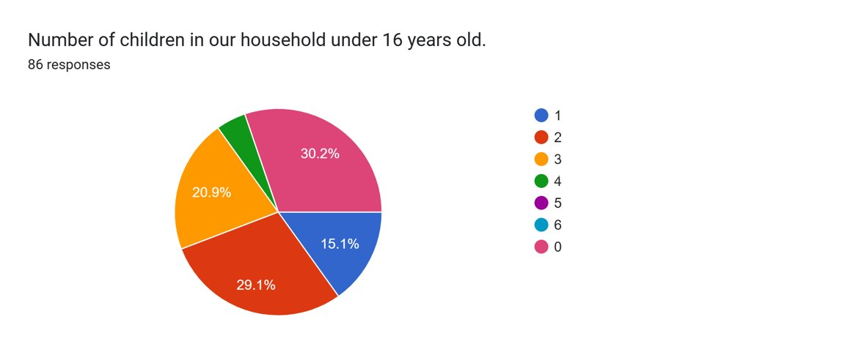
Social: Survey Results

Slide 34
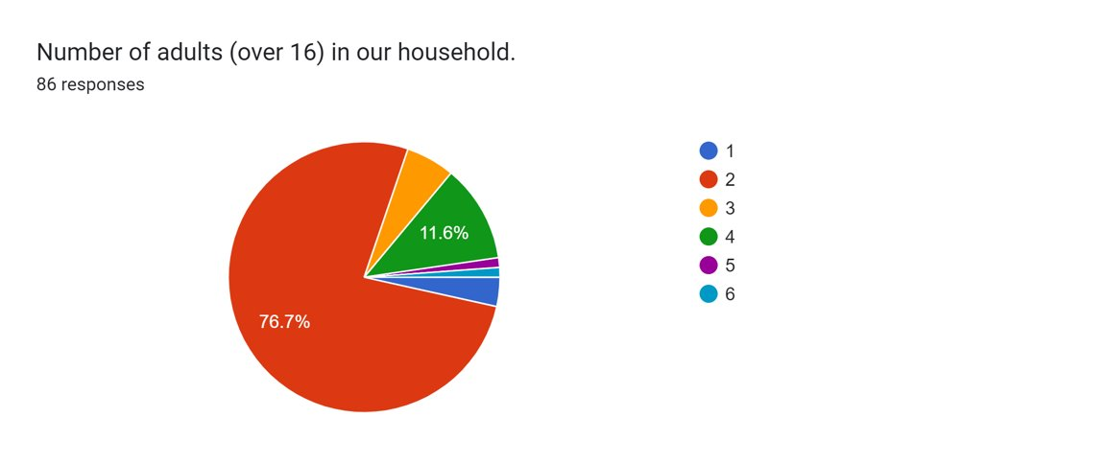
Social: Survey Results

Slide 35
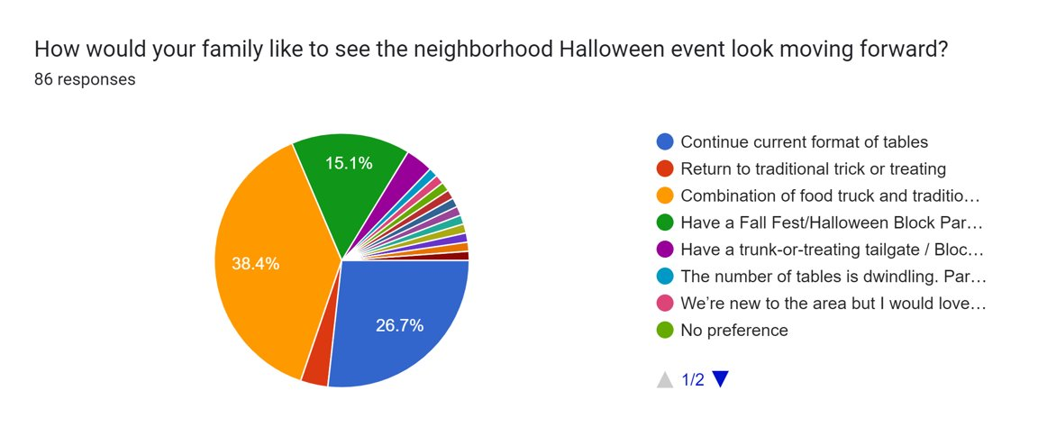
Social: Survey Results

Slide 36
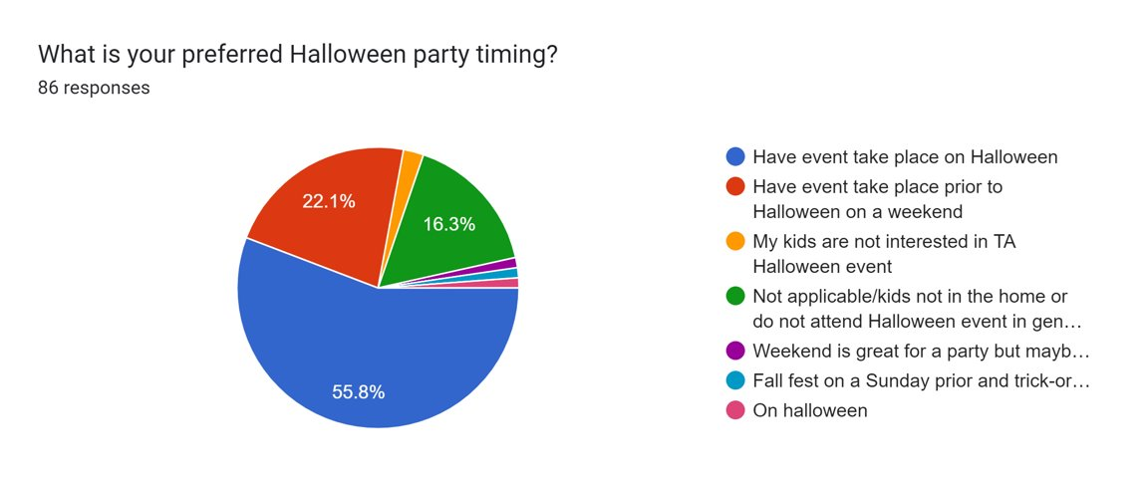
Social: Survey Results

Slide 37
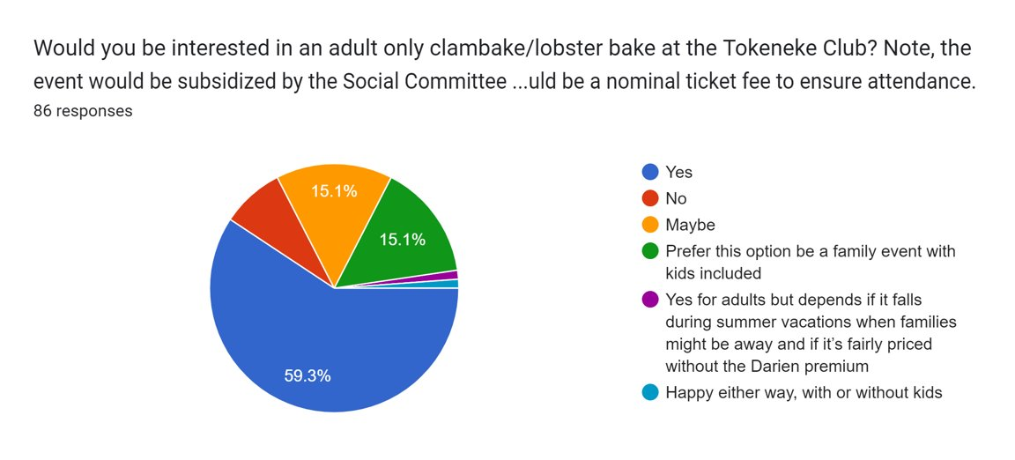
Social: Survey Results

Slide 38
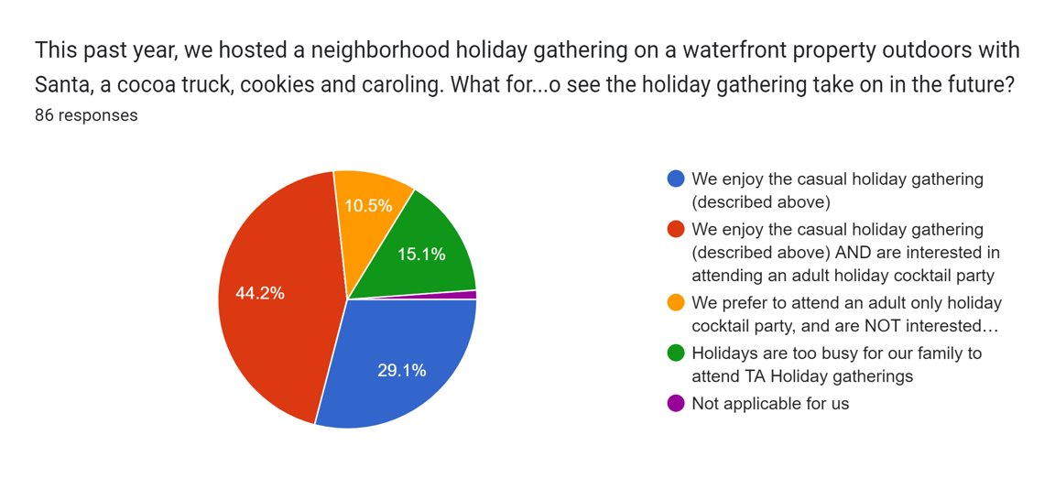
Social: Survey Results

Slide 39
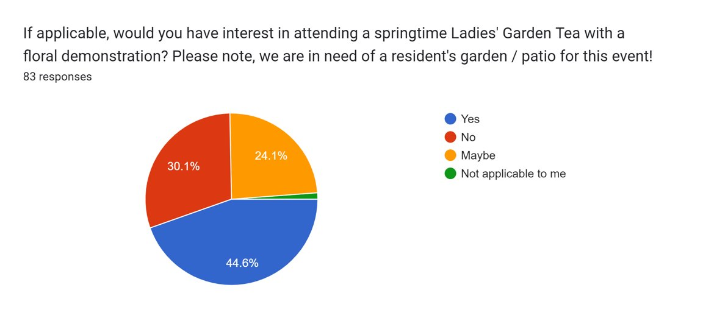
Social: Survey Results

Slide 40
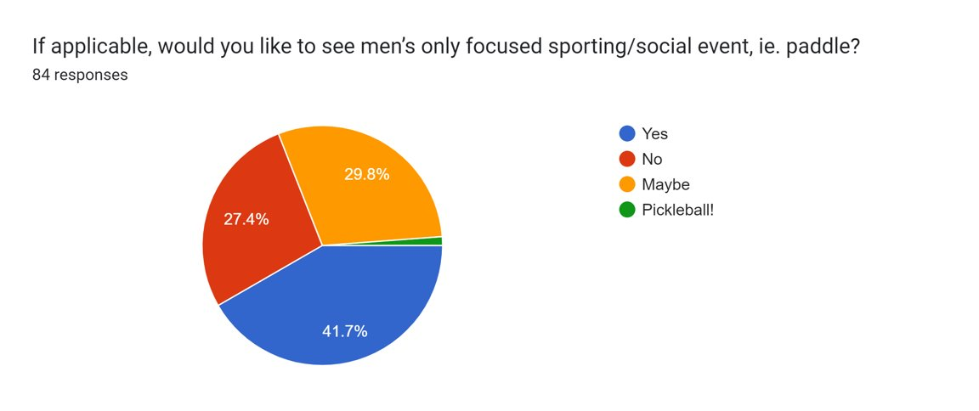
Social: Survey Results

Slide 41
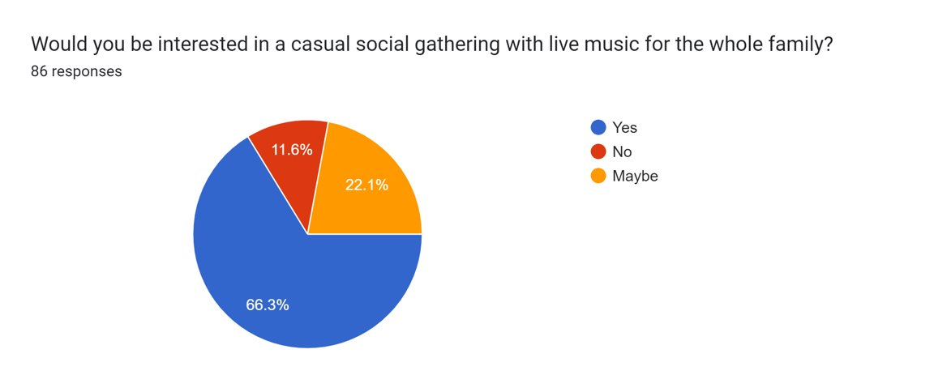
Social: Survey Results

